Slide 1
Automation with Playwright
Tien Nguyen

Slide 2
Playwright introduction
Playwright basic functions
Playwright additional features
Framework Template
Exercise
Q&A

Slide 3
Playwright Introduction

Slide 4
Playwright Introduction
Playwright overview
Playwright solution
Playwright vs Selenium
The first test case with Playwright

Slide 5
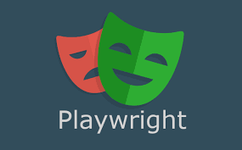
Playwright Overview
Open-source NodeJS-based framework developed by Microsoft
Programming languages: TypeScript, JavaScript, Python, .NET, Java
Cross-browser: Chromium, WebKit, and Firefox
Cross-platform: Windows, Linux, and macOS, headless and headed, mobile web
Auto wait
Tracing
Power tooling: Codegen, Playwright Inspector, Trace viewer
No trade-offs
Notes:
Auto-wait. Playwright waits for elements to be actionable prior to performing actions. It also has a rich set of introspection events. The combination of the two eliminates the need for artificial timeouts - the primary cause of flaky tests.
Tracing. Configure test retry strategy, capture execution trace, videos, screenshots to eliminate flakes.
Codegen. Generate tests by recording your actions. Save them into any language.
Playwright inspector. Inspect page, generate selectors, step through the test execution, see click points, explore execution logs.
Trace Viewer. Capture all the information to investigate the test failure. Playwright trace contains test execution screencast, live DOM snapshots, action explorer, test source, and many more.

Slide 6
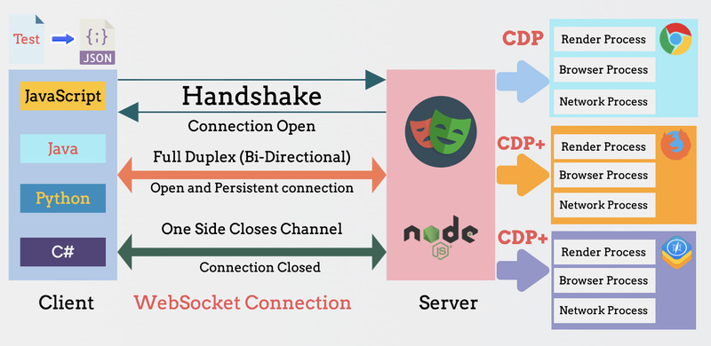
Playwright Solution
Notes:
https://www.programsbuzz.com/article/playwright-architecture

Slide 7
Playwright vs Selenium
 | Playwright | Selenium
Solution | Using DevTool Protocol | Using WebDriver API
Open-source | Yes | Yes
Browser Support | Chromium, Firefox, and WebKit , Safari, Edge | Chrome, Firefox, Edge, Safari...
Platform | Windows, Linux, and macOS | Windows, Linux, and macOS
Programming language | Java, Python, .NET C#, TypeScript and JavaScript. | Java, Python, C#, Ruby, Perl, PHP, and JavaScript
Features | Provide more modern features like smartwait, working with shadow dom, switch to iframe easily, test retry, visual validation... | Need to implement these features by ourselves.
Locator | Introduce many new kinds of selector | Basic selector
Code Generation | Support Codegen to generate code | Can use Selenium IDE
Building automation framework | Easy to build with a lot of built-in features like running test in parallel, report, capturing screenshot and video, cross-browser | Need to have knowledge about many libraries and combine all of them to create a new framework.
CICD Integration | Yes | Yes
Community | Smaller community | Larger community

Slide 8
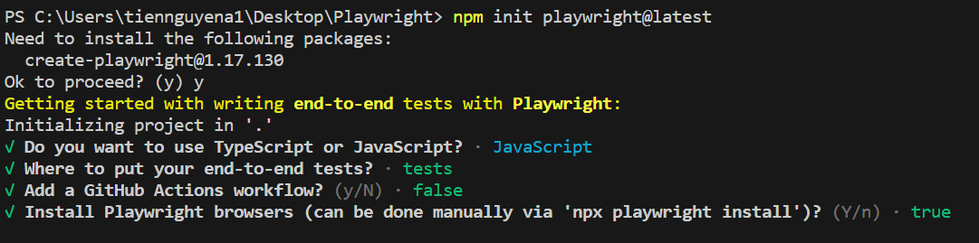
The first test case with Playwright
Install NodeJs
Install VS Code and Playwright extension(Playwright Test for VS Code)
Run “npm init playwright@latest” and choose below options

Slide 9
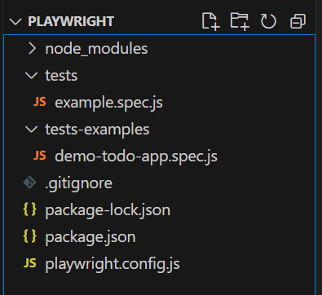
The first test case with Playwright
Test case
Git ignore file
Package.json file
Playwright config file

Slide 10
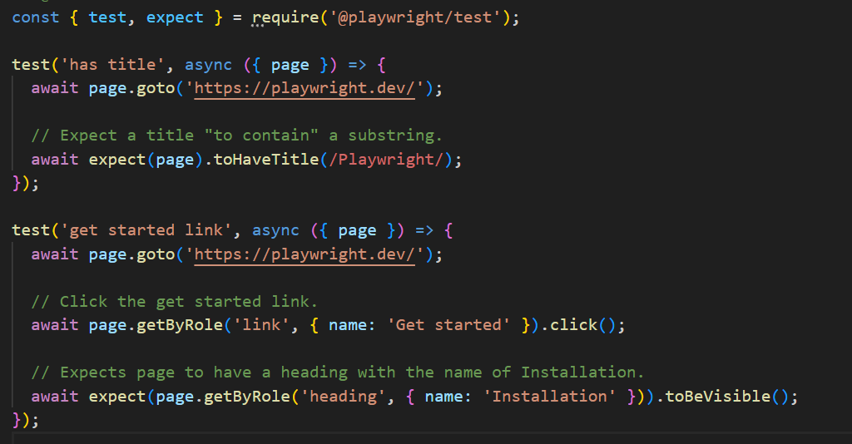
The first test case with Playwright
Playwright Test Case

Slide 11
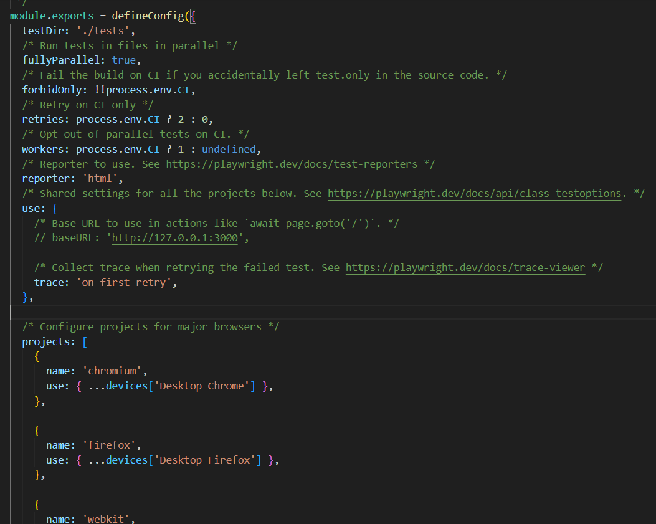
The first test case with Playwright
Playwright Config

Slide 12
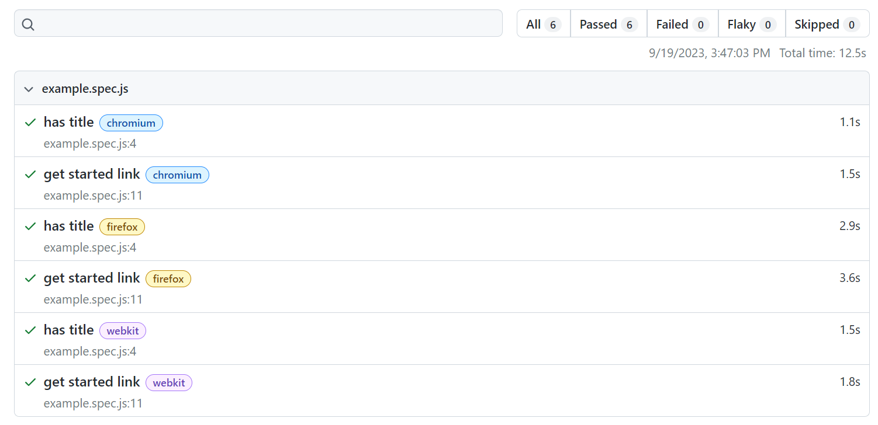
The first test case with Playwright
Run the test case
“npx playwright test”
Run test in UI mode:
“npx playwright test --ui”
Show the report
“npx playwright show-report”

Slide 13
Playwright basic functions

Slide 14
2. Playwright basic functions
Browser, Browser Context and Page
Locator
Element Interaction
Wait
Assertion
Data-driven
Report
Fixtures
Test Hook
Playwright configuration
Filter test case for running test
API Request
Playwright commands

Slide 15
2.1 Browser, Browser Context & Page
Browser
BrowserContext
BrowserContext
BrowserContext
Page
Page
Page
Page

Slide 16
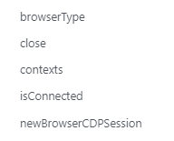
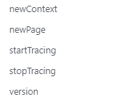
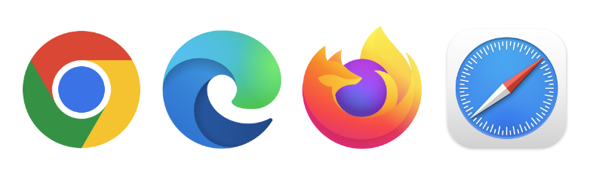
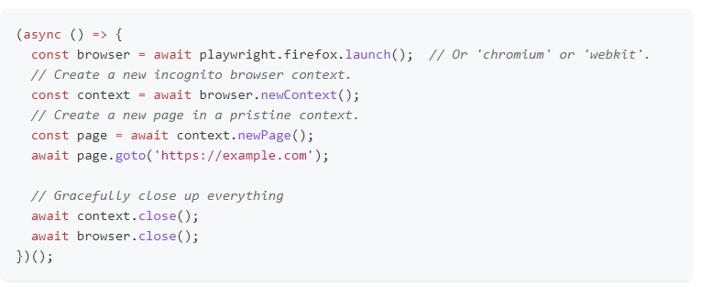
2.1.1 Browser

Slide 17
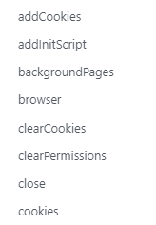
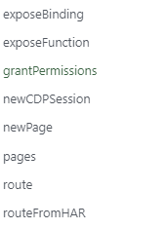
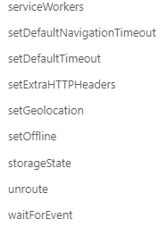
2.1.2 Browser Context
Notes:
A BrowserContext is an isolated incognito-alike session within a browser instance.
Comparing to instantiating browser for every test cases, it is faster and cheaper to create a new browser context
A Browser can create multiple Browser Contexts
A Browser Context can create multiple Pages
Can be used to emulate multi-page scenarios involving mobile devices, permissions, locale, color scheme
Never Restart a Browser
Slow instantiation (>100 ms)
Huge memory overhead
Always create Browser Contexts
Full isolation
Fast instantiation (~1ms)
Low overhead

Slide 18
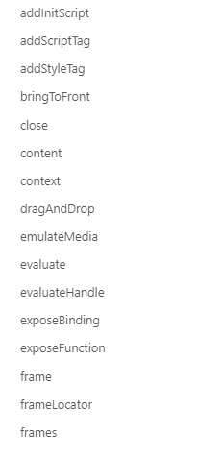
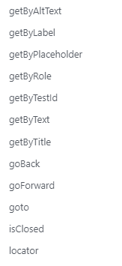
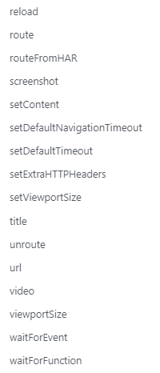
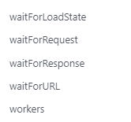
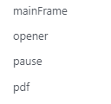
2.1.3 Page
Notes:
A Page refers to a single tab or a popup window within a browser context
Page is used to navigate to URLs and interact with the page content

Slide 19
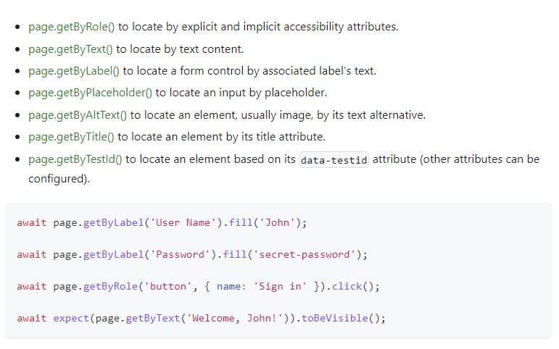
2.2 Locator
New locators introduced by Playwright

Slide 20
2.2 Locator
Page.locator(‘text=ming’)
Page.locator(‘css=[aria-hidden=true]’)
Page.locator(‘xpath=//html/body/a’)
Page.locator(‘.something >> visible=true >> nth=2’) // nth: selector engine -> 0-based
Page.locator(‘:nth-match(:text(“Buy”), 3)’) // CSS pseudo-class -> 1-based
Page.locator(‘role=checkbox[checked][include-hidden])
Page.locator(‘id=username’)
Page.locator(‘data-test-id=submit’)
Page.locator(‘data-testid=1234’)
Page.locator(‘data-test=test’)
Old style of locator, but not recommend

Slide 21
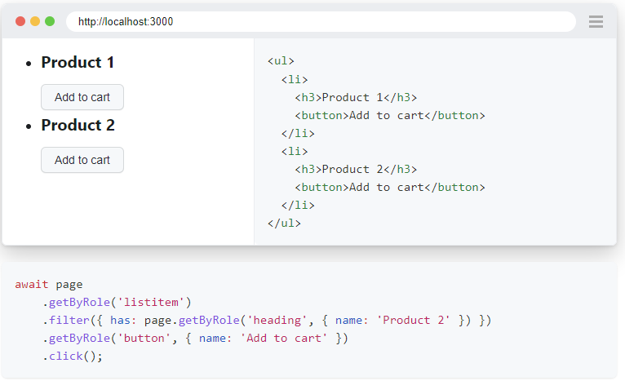
2.2 Locator
Filtering Locators
By text
By not have text
By child/descendant
by not having child/descendant

Slide 22
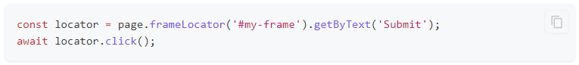
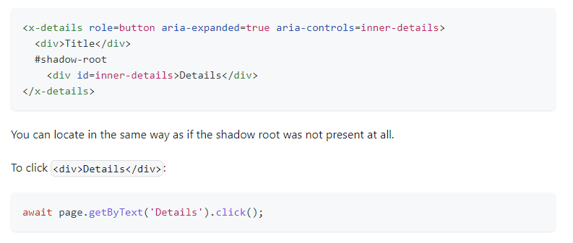
2.2 Locator
Frame locator
Shadow DOM locator
Vue locator
React locator
Angular locator
Custom selector engines

Slide 23
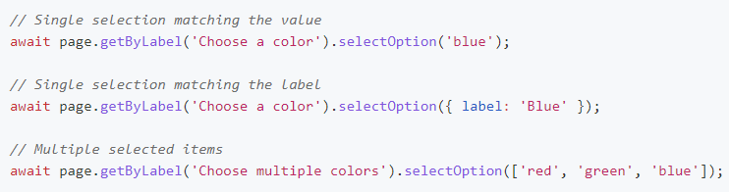
2.3 Element interaction
fill
check
isChecked
selectOption
click
dblclick
hover
press
setInputFiles
focus
dragTo

Slide 24

2.4 Wait
Auto Wait
Wait Function

Slide 25
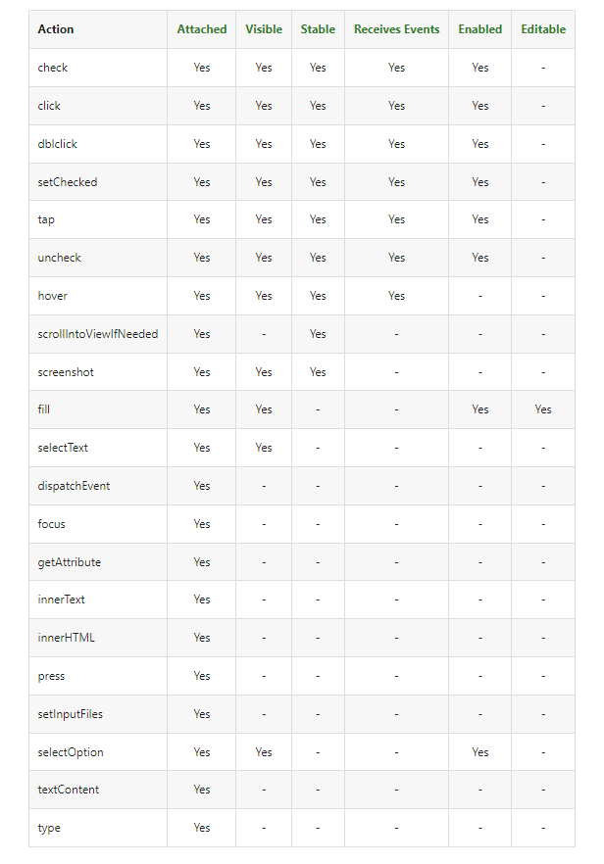
2.4.1 Auto Wait

Slide 26
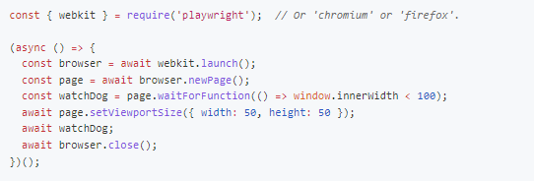
2.4.1 Wait Function
waitForEvent
waitForFunction
waitForLoadState
waitForRequest
waitForResponse
waitForUrl

Slide 27
2.5 Assertion
Generic Assertion
toBe
toBeGreaterThan
toBeLessThan
toEqual
toContain
toMatch
…
Locator Assertion
toBeDisabled
toBeChecked
toBeFocused
toContainText
toHaveText
toHaveValue
…
Page Assertion
toHaveScreenshot
toHaveTitle
toHaveUrl
SnapshotAssertions
toMatchSnapshot

Slide 28
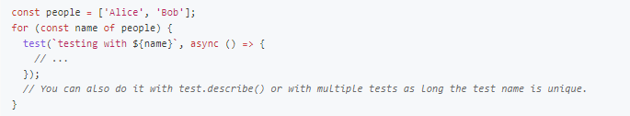
2.6 Data Driven
Parameter Test
Parameter Project
Environment Variable

Slide 29
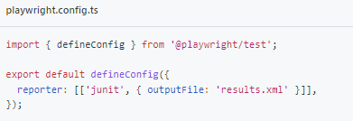
2.7 Report
Built-in report: HTML, Json, Junit,…
Allure report
ReportPortal report

Slide 30
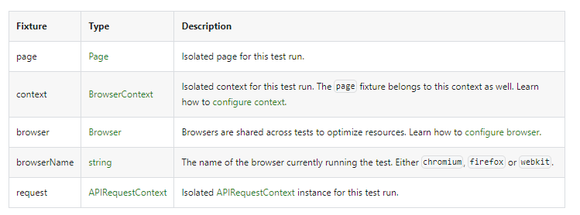
2.8 Fixtures
Test fixtures are used to establish environment for each test, giving the test everything it needs and nothing else. Test fixtures are isolated between tests. With fixtures, you can group tests based on their meaning, instead of their common setup.

Slide 31
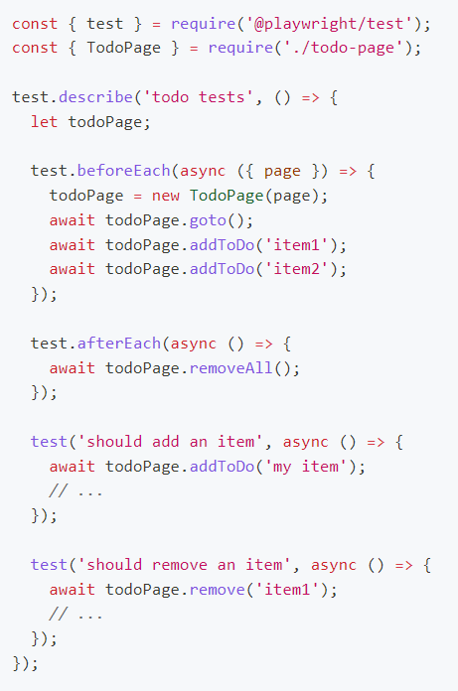
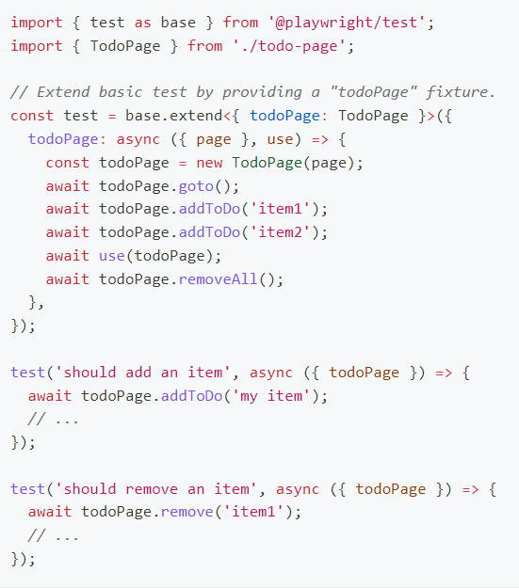
2.8 Fixtures
With fixtures
Without fixtures

Slide 32
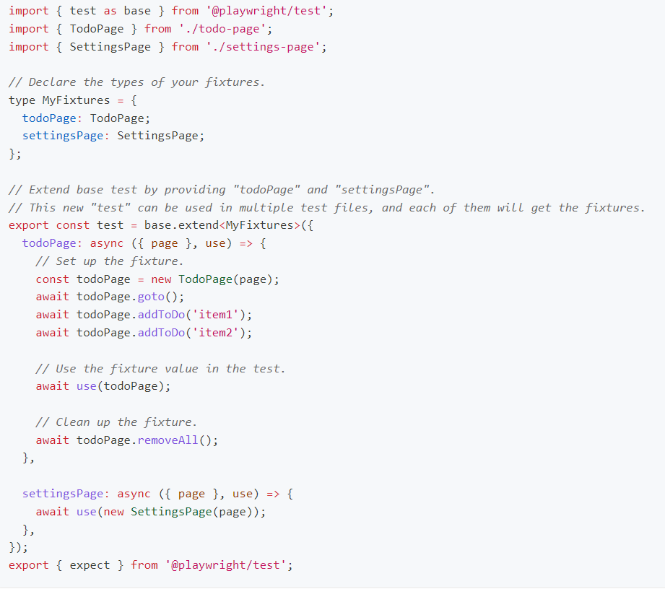
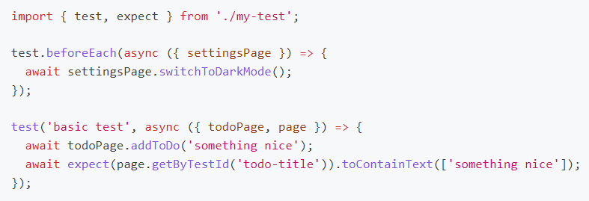
2.8 Fixtures
Use fixtures
Define fixtures
Notes:
Fixture scope
Fixture order

Slide 33
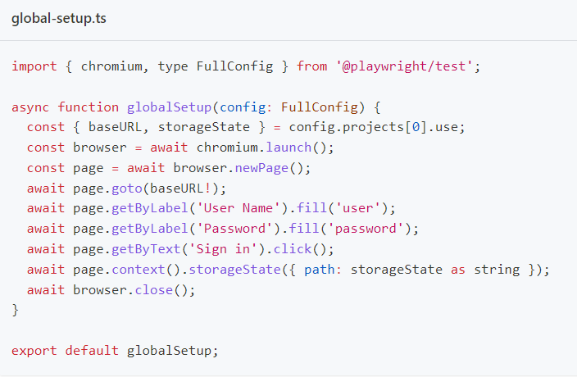
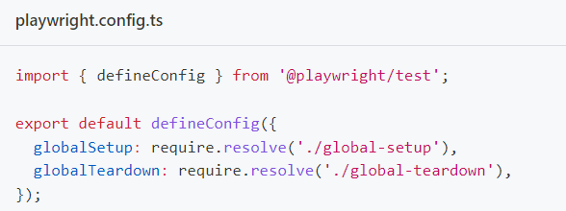
2.9 Test Hook
beforeAll
beforeEach
globalSetup
afterAll
afterEach
globalTeardown

Slide 34
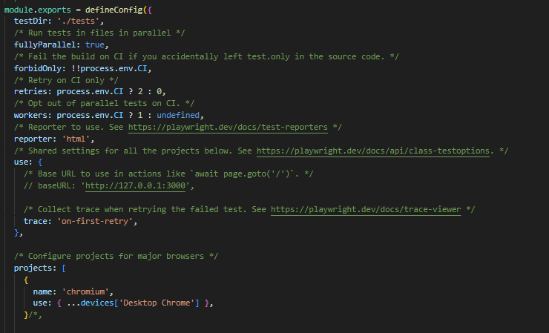
2.10 Playwright configuration
Set test directory
Running test in parallel
Choose browser
Set report type
Global Setup/ Teardown

Slide 35
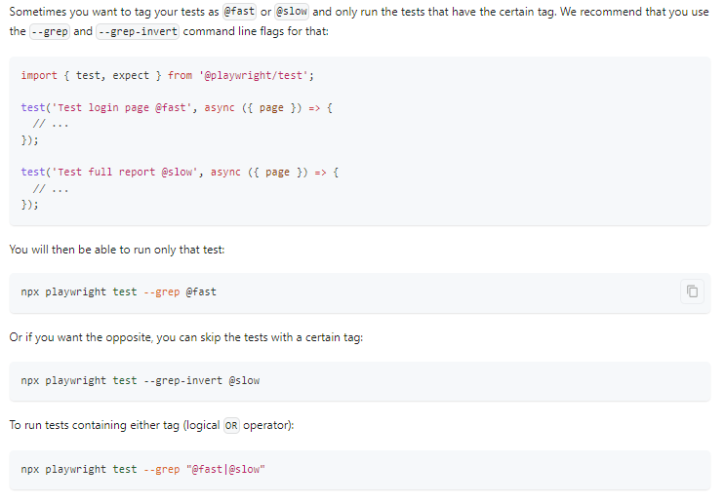
2.11 Filter test case for running test

Slide 36
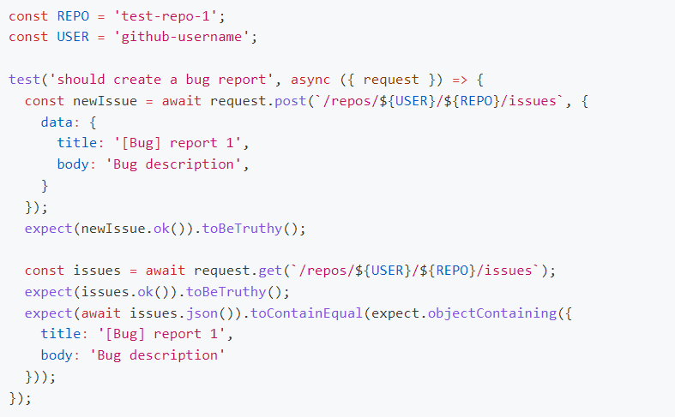
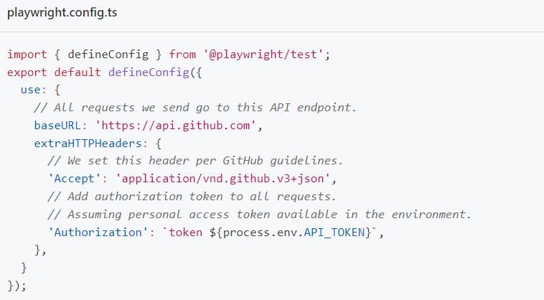
2.12 API Request

Slide 37
2.13 Playwright commands
npx playwright test
npx playwright test tests/todo-page.spec.ts
npx playwright test tests/todo-page/ tests/landing-page/
npx playwright test my-spec my-spec-2
npx playwright test -g "add a todo item“
npx playwright test –headed
npx playwright test --project=firefox,chrome
npx playwright test --workers=1
npx playwright test --reporter=dot
npx playwright test –debug
npx playwright test --help
Run all the tests in all projects
Run a single test file
Run a set of test files
Run files that have my-spec or my-spec-2 in the file name
Run the test with the title
Run tests in headed browsers
Run tests in particular configuration (project)
Disable parallelization, run test with 1 worker
Run test with dot reporter
Run in debug mode with Playwright Inspector
Ask for help

Slide 38
Playwright additional features

Slide 39
3. Playwright additional features
VS Code Extension
Playwright Tracing
Networks
Emulation

Slide 40
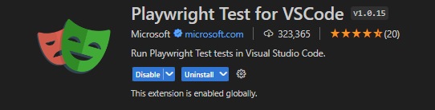
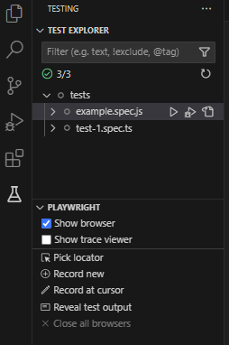
3.1 VS Code Extension
Running single/multiple test
Select browser
Pick locator
Debug
Record test case

Slide 41
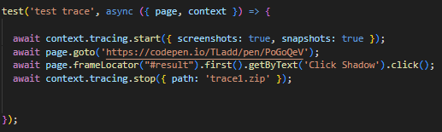
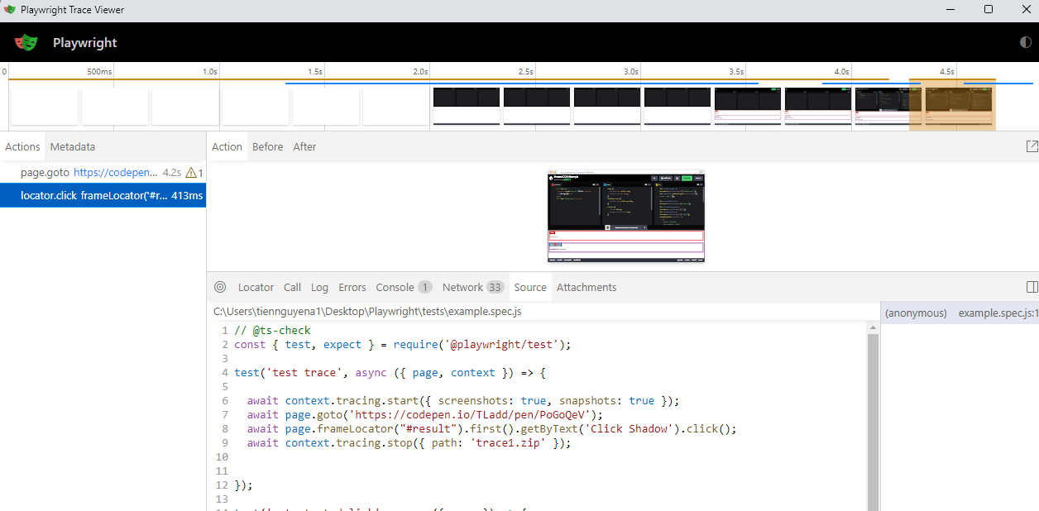
3.2 Playwright Tracing
Useful tool for debugging

Slide 42
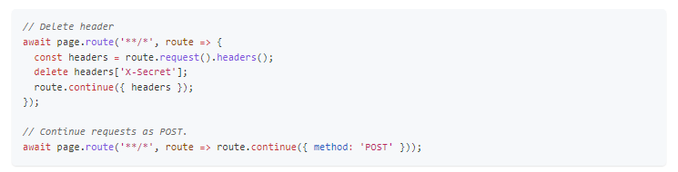
3.3 Networks
Mocking API
Authentication
Proxy
Modify request
Abort request
Modify response
…

Slide 43
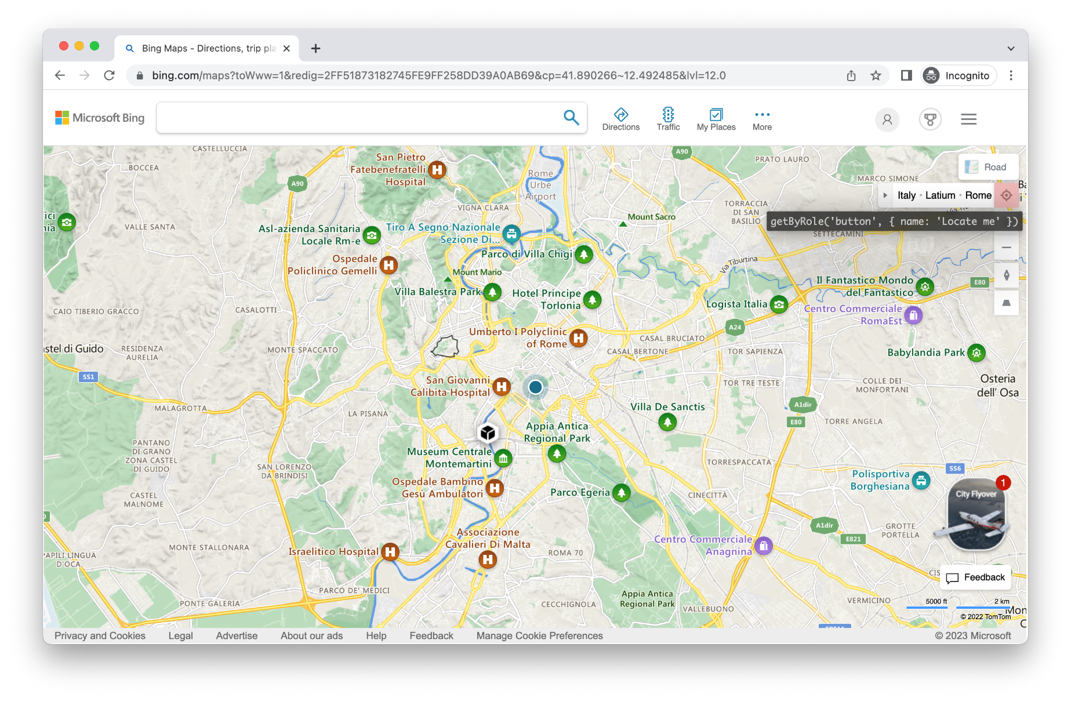
3.4 Emulation
Device
Viewport
Locale & Time zone
Permission
Geolocation
Color schema and media

Slide 44
Framework Template

Slide 45
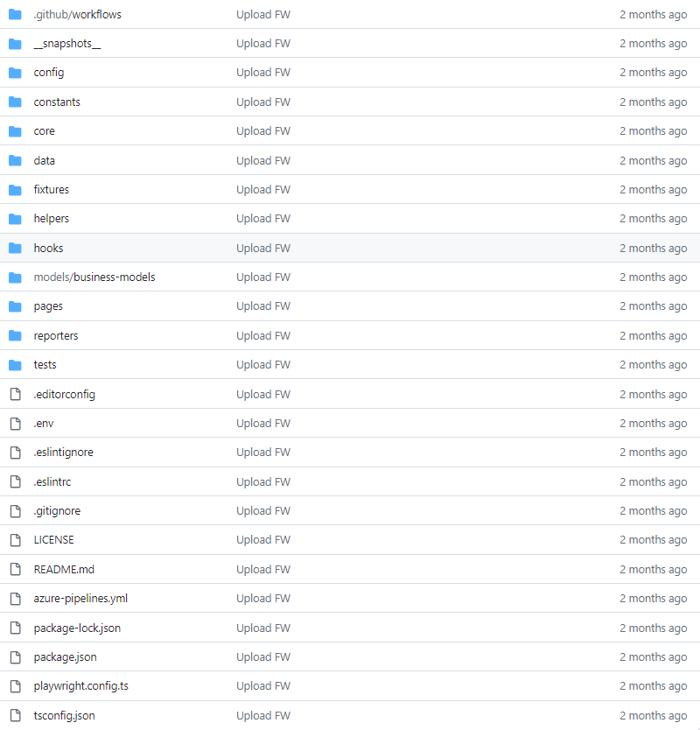
4. Framework Template

Slide 46
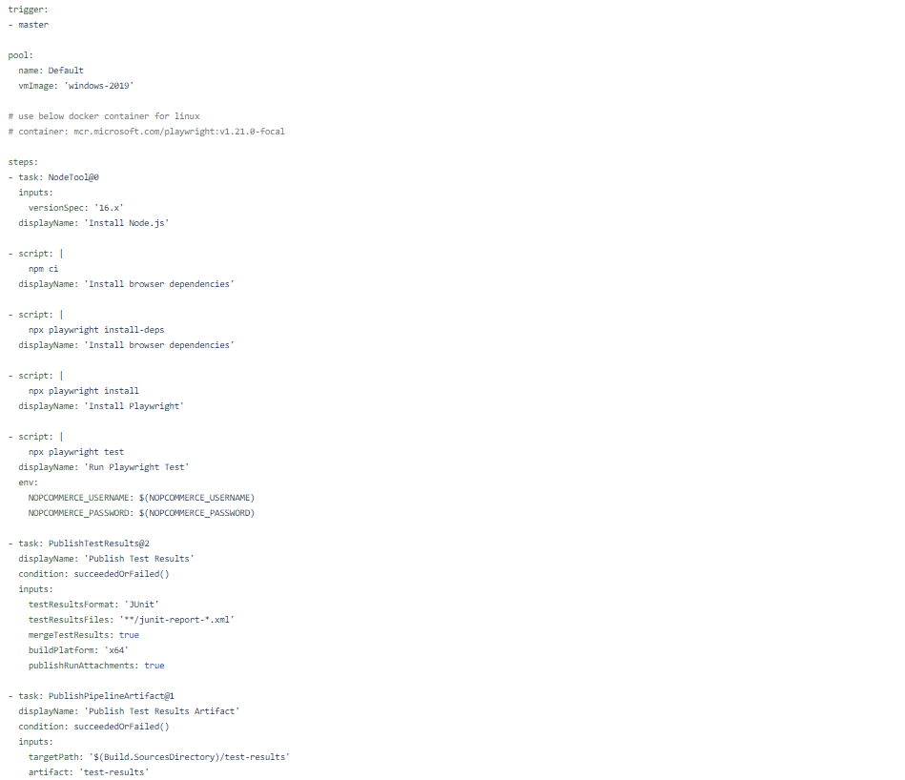
4. Framework Template
Azure DevOps yml file

Slide 47
Reference
https://playwright.dev/docs/intro
https://www.programsbuzz.com/article/playwright-architecture

Slide 48
5. Exercise
NT_TD_001_Template_FinalExamination_CourseCode_AutomationWithPlaywright.docx

